Slide 1
SIEMENS
Case Study and Validation of SIL-KIT-Integrated In-Vehicle Network: Architectures Using Digital Twin Simulation
Integration of SIL-KIT with IVN
Simulation-based validation of in-vehicle network communication using CARLA, SIL-KIT, Gateway, AUTOSAR algorithm, and Vector CANoe dashboard.
Final Project Presentation
Beni Suef University Team
16/06/2025

Slide 2
SIEMENS
PRESENTATION ROADMAP
Presentation Agenda
A structured walkthrough of the SIL-KIT integration project, from simulation setup to CAN communication validation and final demo.
01
Project Objective
05
Connection Modes
Purpose of integrating SIL-KIT with the in-vehicle network simulation.
Comparison between Legacy, SIL-KIT, and Hybrid connection approaches.
02
AUTOSAR Software Architecture
06
CAN Frame Structure
Runnable structure, triggering events, and software component flow.
CAN FD frame metadata, payload mapping, byte order, and signal interpretation.
03
SIL-KIT Modes
07
AEB System Overview
Comparison between Coordinated Mode and Autonomous Mode.
End-to-end AEB workflow from CARLA sensor data to vECU response and vehicle actuation.
04
System Architecture
08
Integration Demo & Validation
Overview of CARLA, Gateway, SIL-KIT, AUTOSAR/vECU, and dashboard tools.
Live demonstration of CAN frame exchange, SIL-KIT dashboard monitoring, Gateway logs, and vECU signal reception.

Slide 3
SIEMENS
SECTION 01
Project Objective
Purpose of integrating SIL-KIT with the in-vehicle network simulation.
01

Slide 4
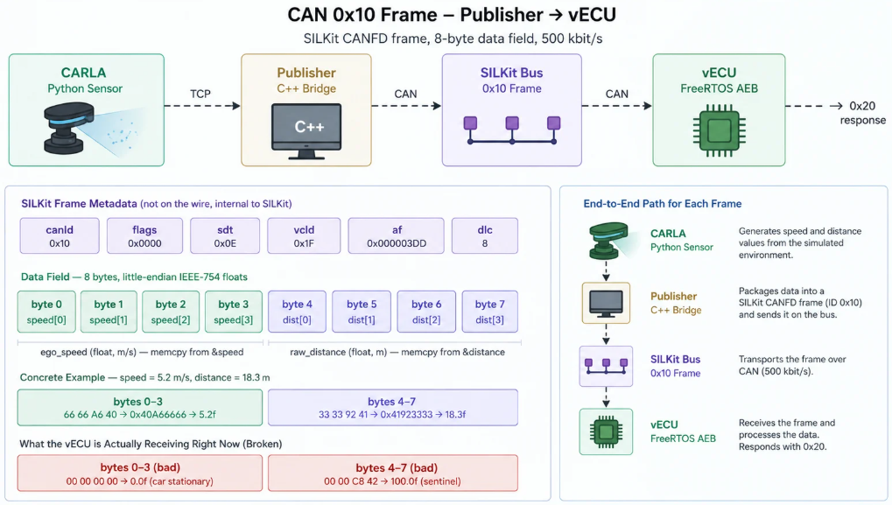
SIEMENS
Project Objective
Purpose of integrating SIL-KIT with the in-vehicle network simulation.
The objective of this project is to integrate SIL-KIT with an in-vehicle network simulation environment to enable reliable communication between CARLA, Gateway, AUTOSAR/vECU, and dashboard tools.
Key goals:
01 — Build the communication chain
Connect CARLA, C++ Gateway, SIL-KIT, AUTOSAR/vECU, and Vector/CANoe dashboard.
02 — Validate CAN frame exchange
Transmit and receive CAN/CAN FD frames correctly across the simulation network.
03 — Monitor system behavior
Use dashboard and logs to verify message flow, signal values, and vECU response.
04 — Demonstrate closed-loop integration
Show that sensor data from CARLA can reach the vECU and return control actions back to the simulation.
Key takeaway:
The project demonstrates a complete software-in-the-loop integration workflow for validating IVN communication before real vehicle deployment.

Slide 5
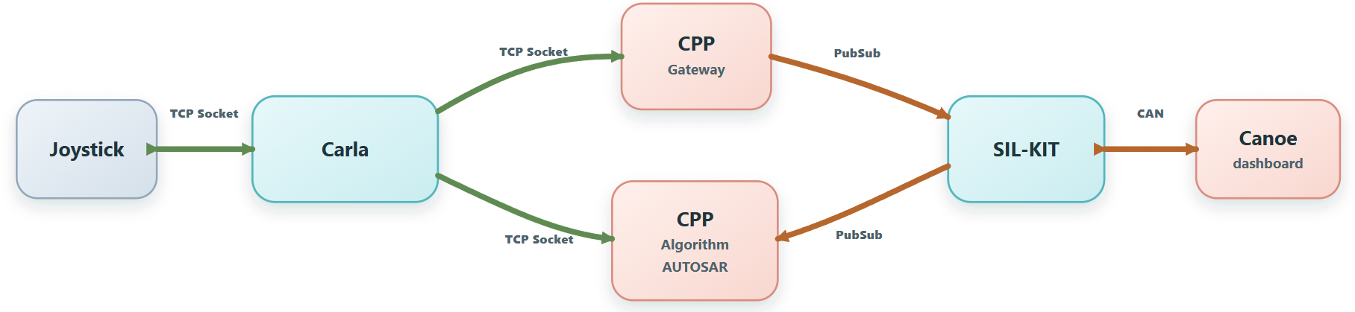
SIEMENS
Pub/Sub-based communication between CARLA, C++ gateway, AUTOSAR algorithm, SIL-KIT, and CANoe dashboard.
Architecture — SIL-KIT Pub/Sub Integration

Slide 6
SIEMENS
SECTION 02
AUTOSAR Software Architecture
Runnable structure, triggering events, and software component flow.
02

Slide 7
SIEMENS
AEBB_SWC
InitRunnable
INIT_Event
AEBB_SWC
ReadSensorRunnable
Software component flow
Timing_Event
SRI1
AUTOSAR Architecture
AEBB_SWC
ProcessDistanceRunnable
DRE_Event1
Structured view of runnable execution blocks, triggering events, and SRI-linked transitions across the control flow.
SRI2
AEBB_SWC
FCW_Runnable
DRE_Event2
SRI3
AEBB_SWC
ActuationRunnable
DRE_Event3
SRI4
AEBB_SWC
WarningActionRunnable

Slide 8
SIEMENS
SECTION 03
SIL-KIT Modes
Comparison between Coordinated Mode and Autonomous Mode.
03

Slide 9
SIEMENS
SIL-KIT Modes
01
Coordinated Mode
02
Autonomous Mode
TIMING
Simulation Manager controls global simulation time
EXECUTION
Independent participant execution
SYNC
Centralized synchronization between participants
TIMING
Each participant controls its own timing

Slide 10
SIEMENS
SECTION 04
System Architecture
Overview of CARLA, Gateway, SIL-KIT, AUTOSAR/vECU, and dashboard tools.
04

Slide 11
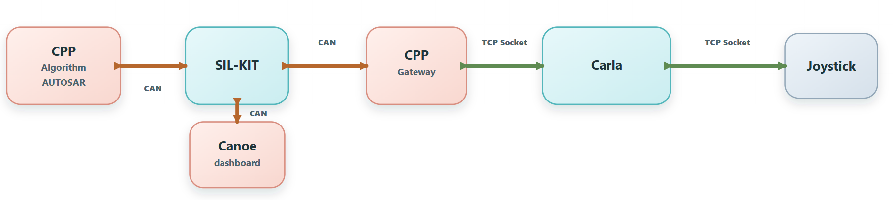
SIEMENS
CAN-based integration chain connecting AUTOSAR algorithm, SIL-KIT, C++ gateway, CARLA, joystick, and CANoe dashboard.
Architecture — CAN-Based Integration Chain

Slide 12
SIEMENS
SECTION 05
Connection Modes
Comparison between Legacy, SIL-KIT, and Hybrid connection approaches.
05

Slide 13
SIEMENS
Connection Modes
LEGACY
SIL-KIT
HYBRID

Slide 14
SIEMENS
SECTION 06
CAN Frame Structure
CAN FD frame metadata, payload mapping, byte order, and signal interpretation.
06

Slide 15
SIEMENS
CAN Frame Structure & Flags
CAN frame structure used to transfer speed and distance signals from the Publisher to the vECU through SIL-KIT.
Frame purpose
This CAN frame carries two main signals required by the vECU:
  Vehicle Speed
  Raw distance
Payload mapping
  Bytes 0–3 → ego_speed
  Bytes 4–7 → raw_distance
  Format: 8-byte CAN FD data field
  Encoding: little-endian IEEE-754 float
Key takeaway:
Correct CAN frame interpretation depends on matching metadata, payload byte order, and signal mapping between Publisher, SIL-KIT, and vECU.

Slide 16
SIEMENS
SECTION 07
AEB System Overview
End-to-end AEB workflow from CARLA sensor data to vECU response and vehicle actuation.
07

Slide 17
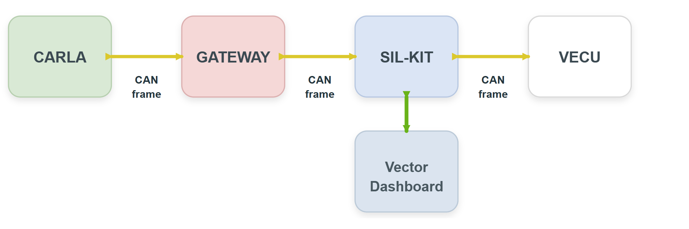
SIEMENS
System Overview
Final Project Architecture

Slide 18
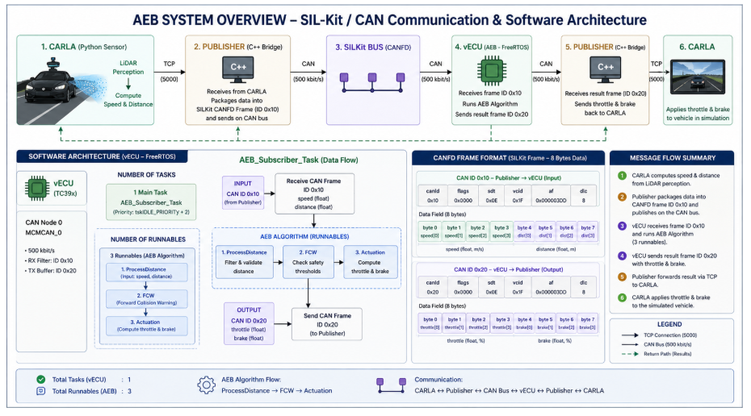
SIEMENS
AEB System Overview
End-to-end SIL-KIT/CAN communication flow connecting CARLA, Publisher, CAN bus, vECU algorithm, and feedback control.

Slide 19
SIEMENS
SECTION 08
Integration Demo & Validation
Live demonstration of CAN frame exchange, SIL-KIT dashboard monitoring, Gateway logs, and vECU signal reception.
08

Slide 20
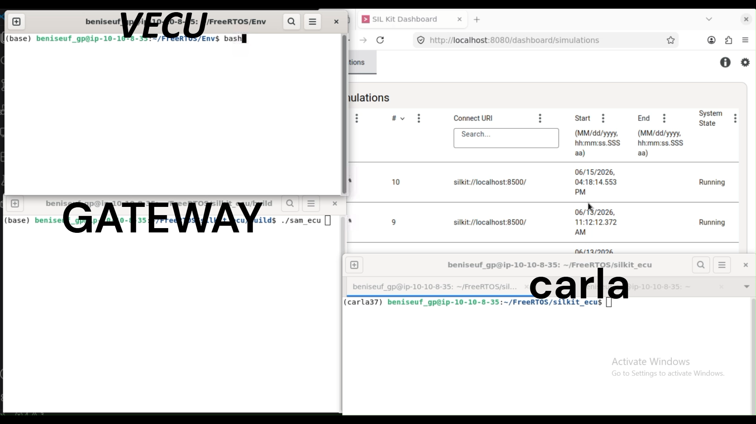
SIEMENS
Integration Demo Video
Live validation of CAN communication between CARLA, Gateway, SIL-KIT dashboard, and vECU.
The demo shows real-time CAN frame exchange, SIL-KIT network monitoring, Gateway communication logs, and vECU response behavior during the simulation.

Slide 21
SIEMENS
FINAL SECTION
Conclusion
Successful integration of SIL-KIT with an in-vehicle network simulation environment.
Key outcomes
CARLA
Simulation input
01
End-to-end communication was established
Gateway
CAN / CAN FD frames were exchanged across CARLA, Gateway, SIL-KIT, and vECU participants.
Signal bridge
02
vECU behavior was validated
SIL-KIT
Communication bus
The vECU received input signals, executed the AEB logic, and generated output responses.
vECU
03
System monitoring was achieved
AEB logic
SIL-KIT dashboard, logs, and Vector / CANoe tools supported message-flow and signal verification.
Dashboard
04
Closed-loop integration was demonstrated
Monitoring
Simulation sensor data reached the vECU and the response was returned back to the simulation path.
Final takeaway: The project provides a scalable SIL-based validation platform for testing IVN communication and AUTOSAR/vECU behavior before real vehicle deployment.

Slide 22
SIEMENS
END OF PRESENTATION
Thank You
Questions & Discussion
Integration SIL-KIT with IVN
CARLA · Gateway · SIL-KIT · AUTOSAR/vECU · CAN / CAN FD · CANoe
Beni Suef University Team

